Slide 1

HEALTHCARE DATABASE MANAGEMENT SYSTEM
Surya Suresh Sriraman
Nivetha Sivakumar

Slide 2



CONTENTS
Introduction
Business Case
Data Model
Data Warehouse
ETL Process
Dashboard
NOSQL Database Structure
AWS Architecture
Advantages of using Snowflake
Conclusion

Slide 3

INTRODUCTION
Transforming Healthcare Management Through Innovation
The healthcare industry confronts multifaceted challenges, including rising costs, an aging population, and an increasing demand for high-quality care.
In response to these complexities, a robust healthcare management system emerges as a key enabler. Our Healthcare Database Management System is pivotal in optimizing resources, enhancing efficiency, and prioritizing patient outcomes.
This presentation delves into the architecture, features, and benefits of our comprehensive healthcare database solution.

Slide 4


BUSINESS USECASE
Executive Dashboards for Healthcare Management :
Create a dashboard with monthly insights on various KPIs to empower healthcare executives with actionable insights for informed decision-making, enhanced strategic planning and resource allocation.
Patient-Centric tool for Medication Availability:
Allow patients to verify tablet availability remotely, ensuring a seamless, patient-centric healthcare experience by providing advance information before visiting the pharmacy.

Slide 5




WHO WILL BE BENIFITTED
Healthcare
Executives
Administrators
Pharmacist
General Public

Slide 6
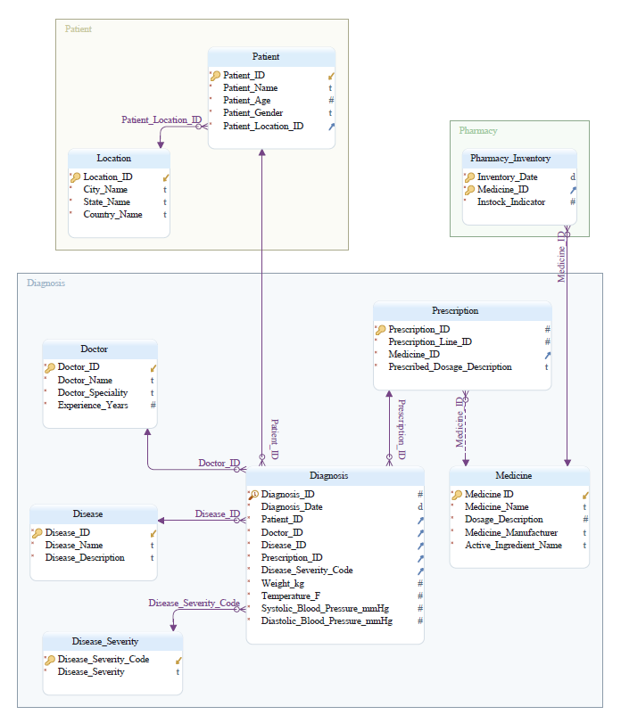
DATA MODEL
Transactional Database
This robust Online Transaction Processing (OLTP) database forms the backbone of our Healthcare Database Management System. Designed for day-to-day operations, it efficiently handles transactional tasks, ensuring real-time data integrity and reliability.
Use Cases:
Patient Registration
Diagnosis Recording

Slide 7
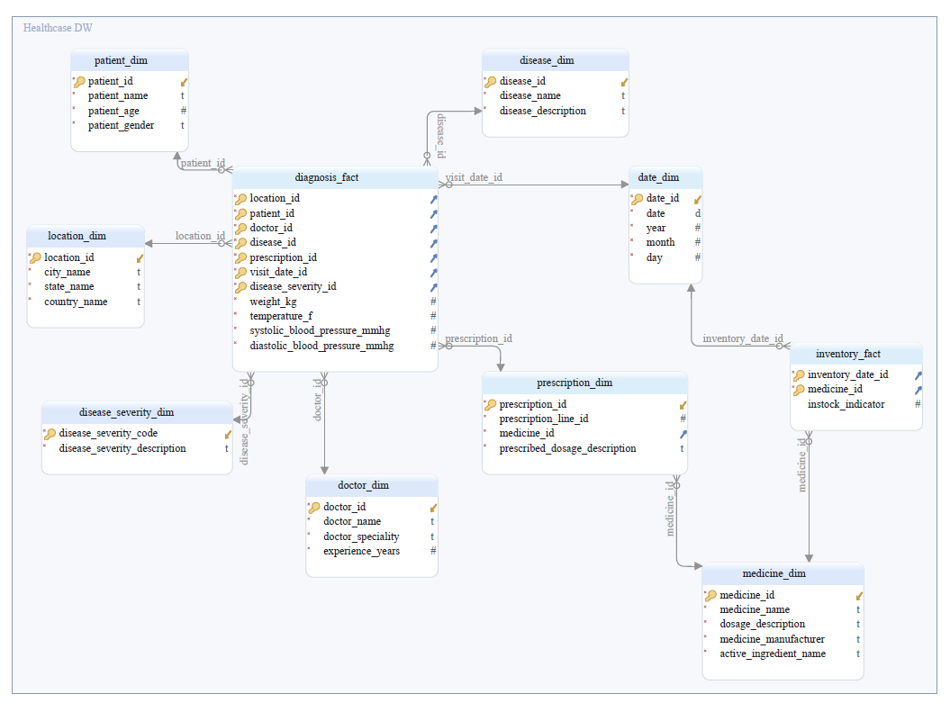
DATA WAREHOUSE
Analytical Database
Our Online Analytical Processing (OLAP) database serves as the analytical powerhouse of the Healthcare Database Management System, enabling comprehensive data analysis and reporting.
Schema:
Diagnosis - Snowflake Schema
Inventory - Star Schema
Use Cases:
Trend Analysis of Disease Incidence
Comprehensive Reporting

Slide 8
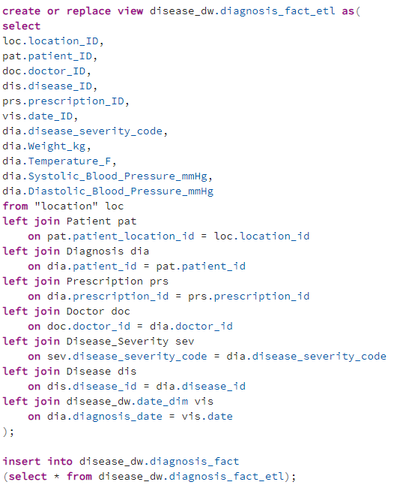
ETL PROCESS
Our Extract, Transform, Load (ETL) process plays a pivotal role in transforming raw healthcare data into a structured, analyzable format within our OLAP database.
Extract data from various sources, including patient records, diagnoses, doctors, diseases, medicines, and pharmacy inventory.
Transform the data to match the structure of our OLAP schema, including creating views for encapsulating the steps needed for diagnosis and medicine facts.
Load the transformed data into the respective dimension and fact tables in the OLAP database.
This ETL process ensures that our OLAP database is periodically updated with the latest healthcare data, providing a foundation for real-time analysis and reporting.

Slide 9
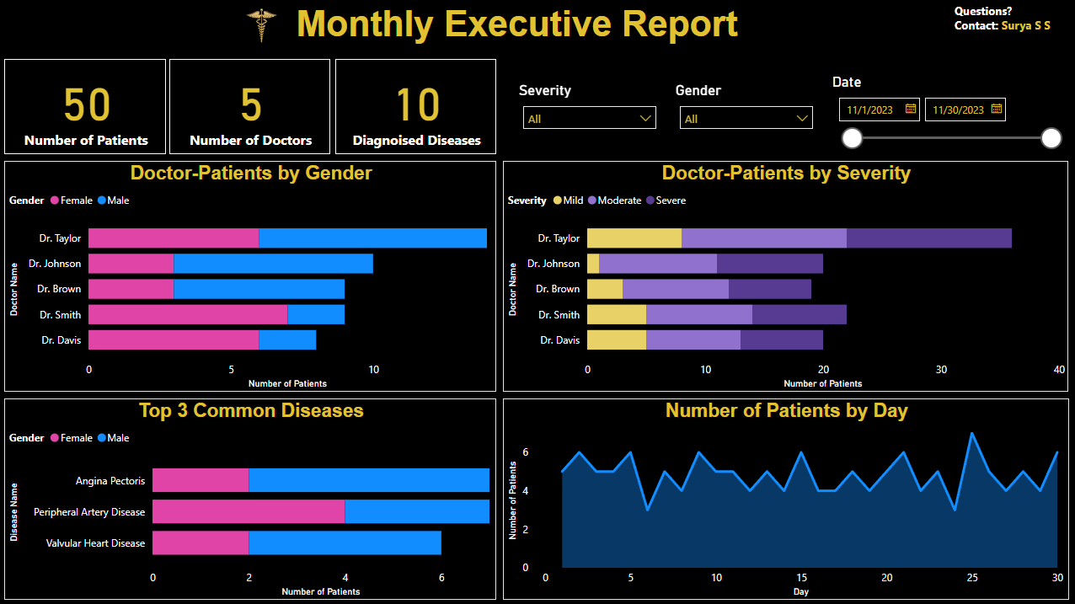

Slide 10
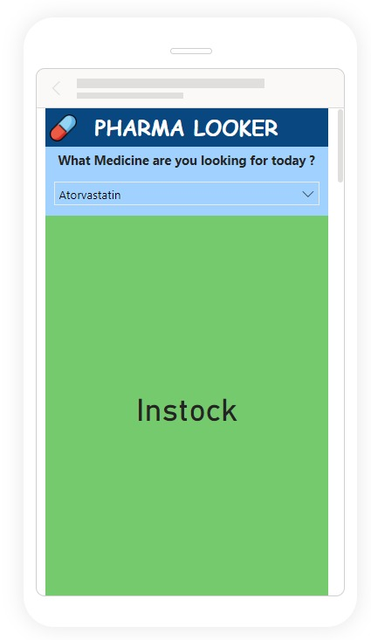
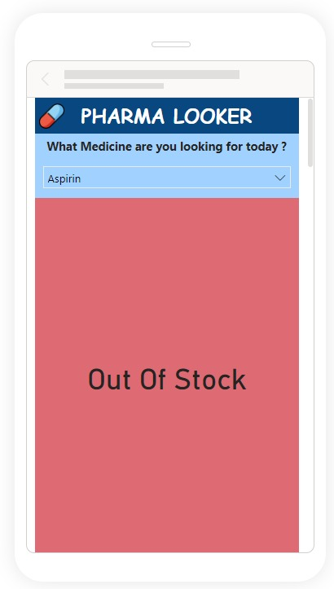
TOOL FOR MEDICATION AVAILABILITY
Objective:
Provide patients with a user-friendly tool to check the availability of prescribed medicines remotely, enhancing the overall healthcare experience.
Key Features:
Access up-to-date information on medicine availability.
Intuitive design for easy navigation and quick results.
Benefits:
Patient-Centric Approach: Enhance patient experience by eliminating uncertainty.
Time and Resource Efficiency: Streamline pharmacy visits with pre-emptive information.

Slide 11

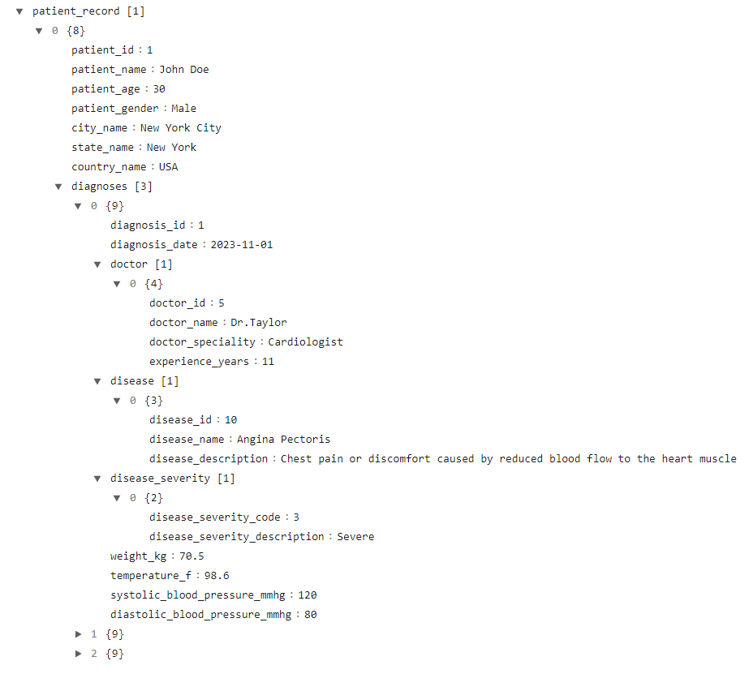






NOSQL Database Structure
Nested Relationships
Flexibile Schema-less Design
Atomic Updates
Denormalization
Embedding Data
Query Performance

Slide 12

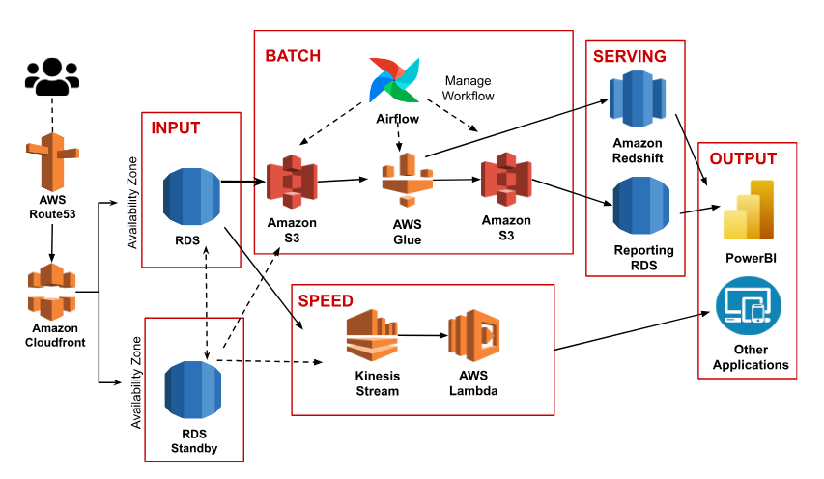
Lambda Architecture

Slide 13




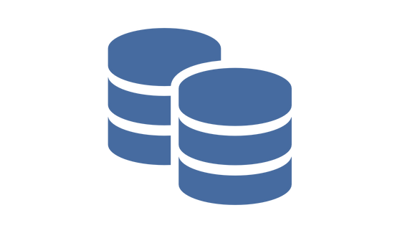

BENIFITS OF USING SNOWFLAKE
Cloud-Native Architecture
Highly scalable and flexible
Data Sharing
Easy and secure sharing
Multi-Cloud Support
High availability and disaster recovery
Concurrency & Performance
Simulatneous Database access
Zero-Copy Cloning
Instant Cloning of databases
Automatic Query Optimization
Enhance overall performance

Slide 14


Slide 15


